Slide 1
CompSci 190: Lecture 14: Classification
Jeff Forbes
November 28, 2018

Slide 2
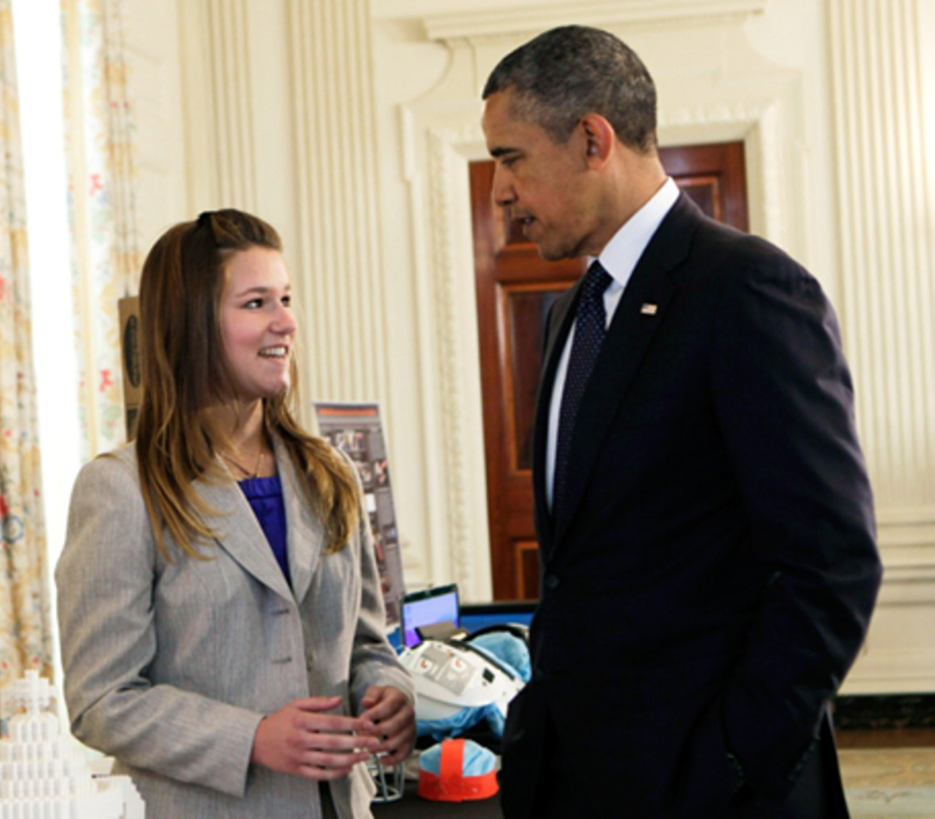
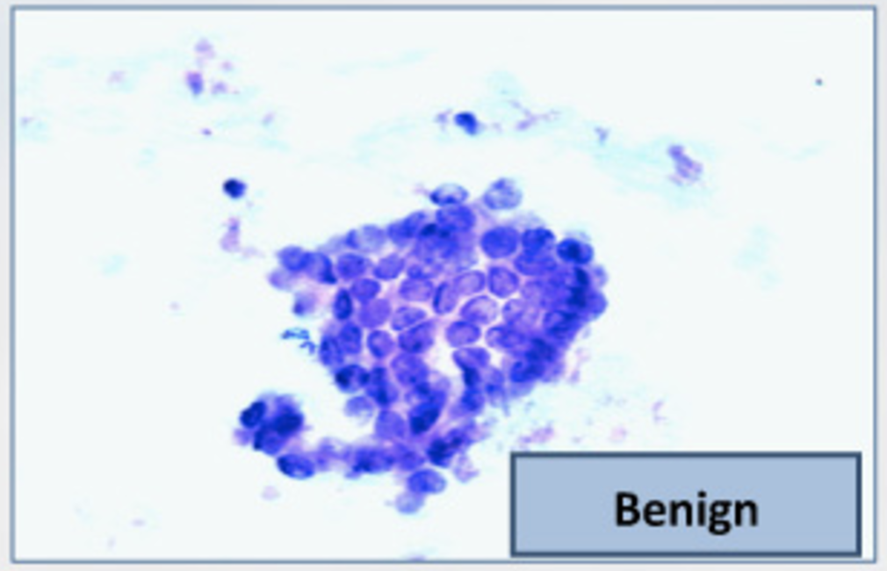
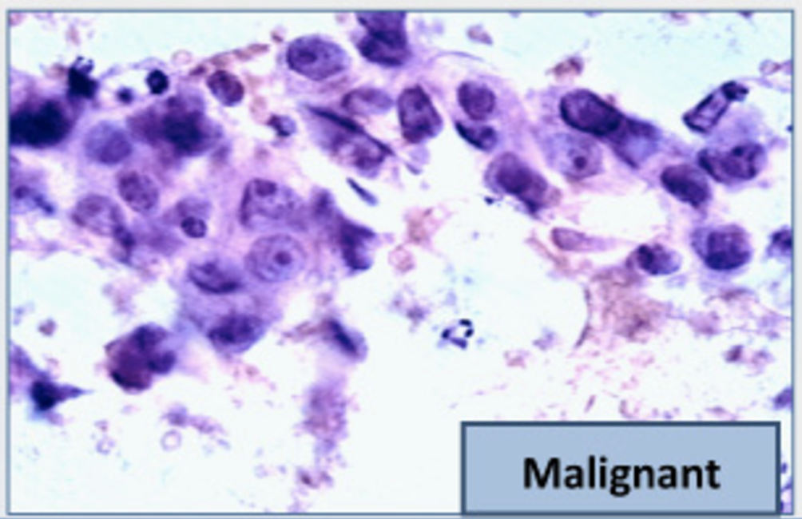
The Google Science Fair
Brittany Wenger, Trinity 2017
Won by 2012 Science Fair building a breast cancer classifier with 99% accuracy
April 22, 2013

Slide 3
Classification Examples
Wenger 2012
(Demo)
Forbes, 1998
Notes:
Fraud: order fraud (Amazon, PayPal, etc.), account fraud (LinkedIn)
Dating: https://www.wired.com/2014/01/how-to-hack-okcupid/
If, through statistical sampling, McKinlay could ascertain which questions mattered to the kind of women he liked, he could construct a new profile that honestly answered those questions and ignored the rest. He could match every woman in LA who might be right for him, and none that weren’t.
Diagnosis: http://www.newyorker.com/magazine/2017/04/03/ai-versus-md
In June, 2015, Thrun’s team began to test what the machine had learned from the master set of images by presenting it with a “validation set”: some fourteen thousand images that had been diagnosed by dermatologists (although not necessarily by biopsy). Could the system correctly classify the images into three diagnostic categories—benign lesions, malignant lesions, and non-cancerous growths? The system got the answer right seventy-two per cent of the time. (The actual output of the algorithm is not “yes” or “no” but a probability that a given lesion belongs to a category of interest.) Two board-certified dermatologists who were tested alongside did worse: they got the answer correct sixty-six per cent of the time.
Personality: https://motherboard.vice.com/en_us/article/how-our-likes-helped-trump-win (Cambridge Analytica—Board member Steve Bannon)
Link personality tests to Facebook profiles
"Followers of Lady Gaga were most probably extroverts, while those who "liked" philosophy tended to be introverts. While each piece of such information is too weak to produce a reliable prediction, when tens, hundreds, or thousands of individual data points are combined, the resulting predictions become really accurate."
"Up to now, explains Nix, election campaigns have been organized based on demographic concepts. "A really ridiculous idea. The idea that all women should receive the same message because of their gender—or all African Americans because of their race." What Nix meant is that while other campaigners so far have relied on demographics, Cambridge Analytica was using psychometrics."
Machine learning to predict recidivism (for parole), to predict whether the bank shoud give you a loan, to predict whether immigrants should be admitted to US. Racism, fairness.

Slide 4
Training a Classifier
Classifier
Attributes of an example
Predicted label of the example
Model the association between attributes & labels
Population
Sample
Labels
Training
Set
Estimate the accuracy of the classifier
Test
Set

Slide 5
Nearest Neighbor Classifier
NN Classifier
Use the label of the most similar training example
Attributes of an example
Predicted label of the example
Population
Sample
Labels
Training
Set
Test
Set

Slide 6
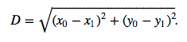
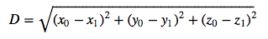
Distance Between Two Points
Two attributes x and y:
Three attributes x, y, and z:
and so on ...
http://bit.ly/FoDS-f18-1128

Slide 7
Rows of Tables
Each row contains all the data for one individual
t.row(i) evaluates to ith row of table t
t.row(i).item(j)is the value of column j in row i
If all values are numbers, then np.array(t.row(i)) evaluates to an array of all the numbers in the row.
To consider each row individually, use for row in t.rows: ... row.item(j) ...
(Demo)

Slide 8
Finding the k Nearest Neighbors
To find the k nearest neighbors of an example:
Find the distance between the example and each example in the training set
Augment the training data table with a column containing all the distances
Sort the augmented table in increasing order of the distances
Take the top k rows of the sorted table
(Demo)

Slide 9
The Classifier
To classify a point:
Find its k nearest neighbors
Take a majority vote of the k nearest neighbors to see which of the two classes appears more often
Assign the point the class that wins the majority vote
(Demo)

Slide 10
Accuracy of a Classifier
The accuracy of a classifier on a labeled data set is the proportion of examples that are labeled correctly
Need to compare classifier predictions to true labels
If the labeled data set is sampled at random from a population, then we can infer accuracy on that population
Sample
Labels
Training
Set
Test
Set
(Demo)

